Slide 1
Similarity In Ejecta Velocity Of Type Ia Supernovae
Toby Heller

Slide 2
Motivation
Not much known definitively about Type Ia Supernovae
We are pretty sure about the progenitor system, but we don’t exactly know what aspects of the progenitor system affect the supernova event, or if they do at all.
Learning about the ejecta velocities can help us understand what the progenitor system is interacting with and how a SNe Ia change over time.

Slide 3
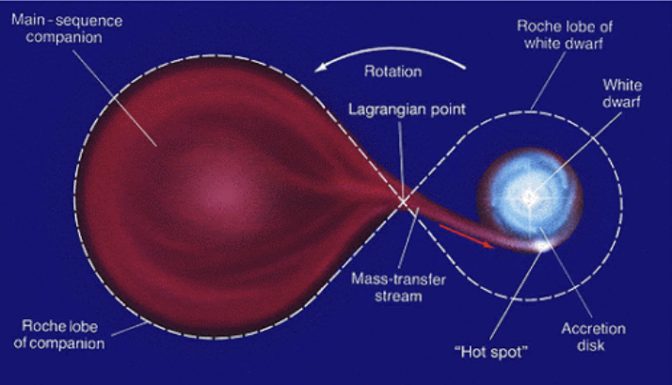

What is a Type Ia Supernova?
Subset of supernovae caused by the accumulation of matter by a white dwarf in a binary system
When the white dwarf exceeds the Chandrasekhar limit (${\sim 1.44M}_{⊙}$), it triggers a fusion reaction
$M_{v}≈−19.3$
Credit: Linda Hall Library

Slide 4
Research Questions
What shape does the distribution of ejecta velocities take (e.g. gaussian, bimodal, etc.)?
To what extent are the velocities uniform?

Slide 5
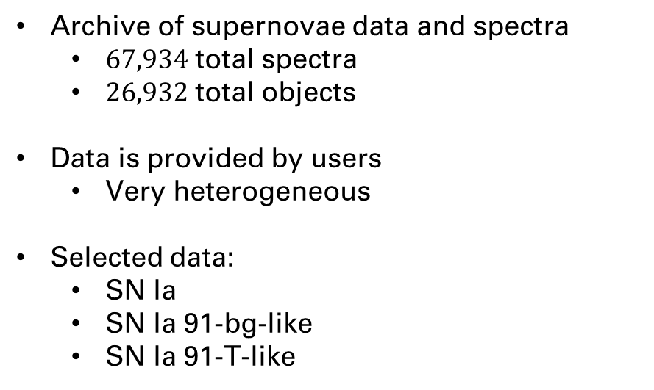
Data: WISeREP
Weizmann Interactive Supernova Data Repository
Archive of supernovae data and spectra
$67,934$ total spectra
$26,932$ total objects
Data is provided by users
Very heterogeneous
Selected data:
SN Ia
SN Ia 91-bg-like
SN Ia 91-T-like

Slide 6
Plan
Select data
Calculate metadata
Filter data using metadata
Preprocess
Filter out bad data (if necessary)
Fit gaussian around KDE/histogram

Slide 7
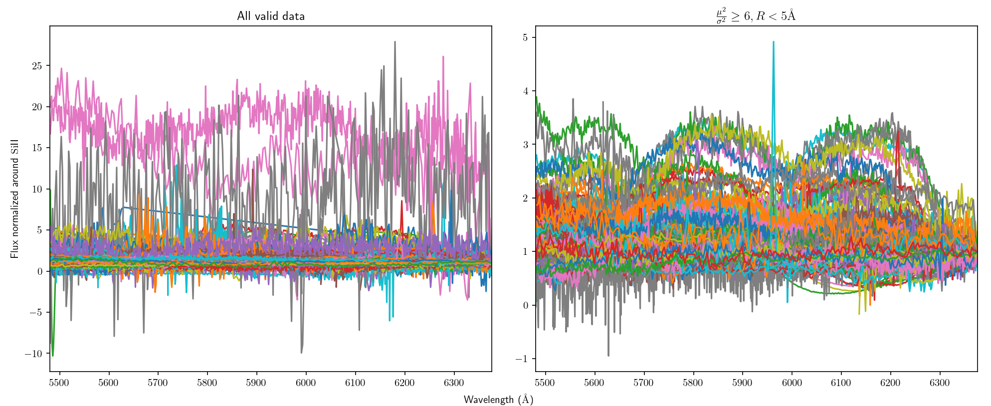


Metadata Filtering
Signal to Noise
$\frac{μ^{2}}{σ^{2}}=≥6$
Mean Spectral Resolution
$R<5Å$

Slide 8
Preprocessing
Redshift normalization
Since I am looking at ejecta velocity, I need to change my data to be in the reference frame of the object

Slide 9
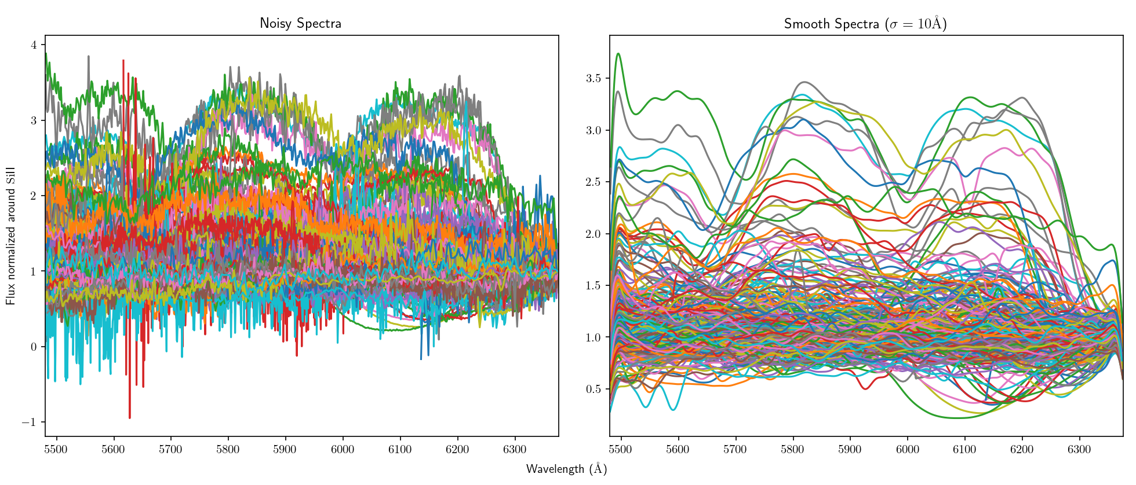
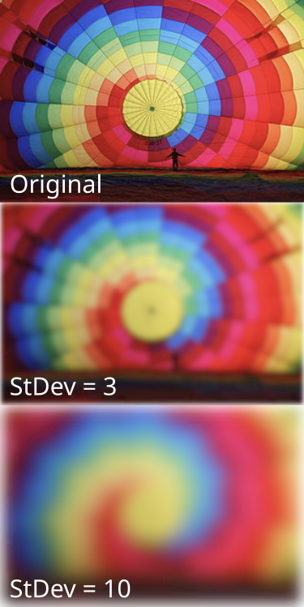
Preprocessing
Smooth data using gaussian filter
gaussian is a low-pass filter
In effect, removes much of the noise
Credit: IkamusumeFan (Wikipedia)

Slide 10
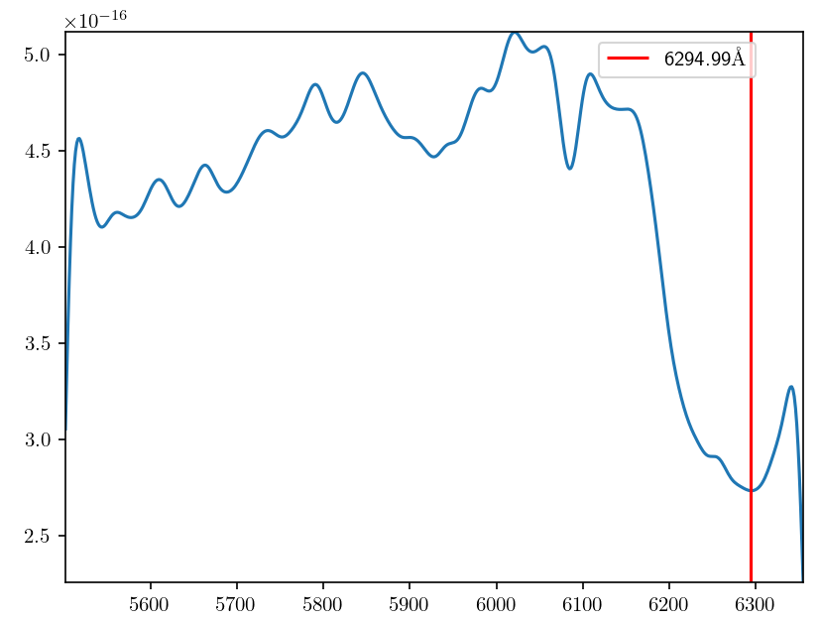
Calculating Velocity
Took simple approach
Assume given redshift is correct
Find relative minima of the smoothed spectrum
Due to the process of a supernova, the first minima below the Si II emission line should be the equivalent Si II absorption line

Slide 11
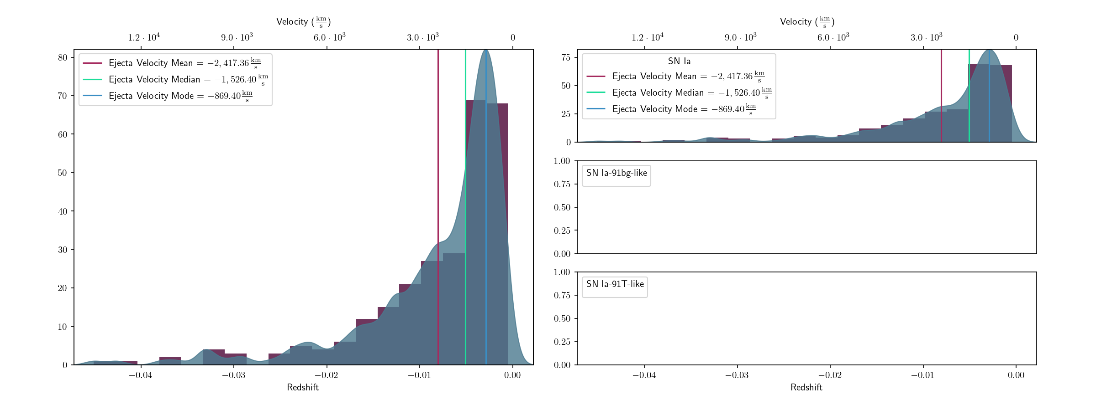
Results
KDE/Histogram

Slide 12
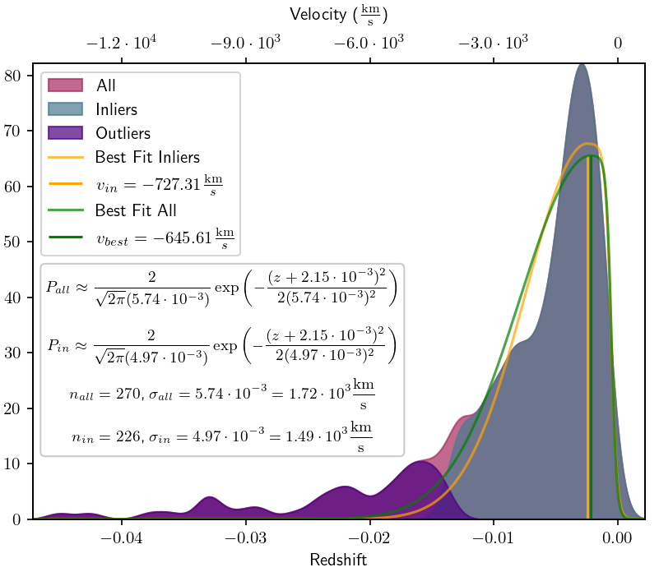

Curve Fitting
Fit half-gaussian curve to KDE
Since some Si II lines have been incorrectly identified, try K-Means Clustering to identify potentially incorrect classifications
Use to find variance and center of the velocity distribution
$$P=\left\{\begin{aligned}\frac{2}{\sqrt{2π} σ_{z}}e^{−\frac{{\left(z−z_{best}\right)}^{2}}{2σ_{z}^{2}} }, z≤z_{best} \\ \frac{1}{\sqrt{2π} σ_{z}}\left(1−\tanh\left(σ_{e}(z−z_{best}\right)−4\right), z>z_{best}\end{aligned}\right.$$

Slide 13
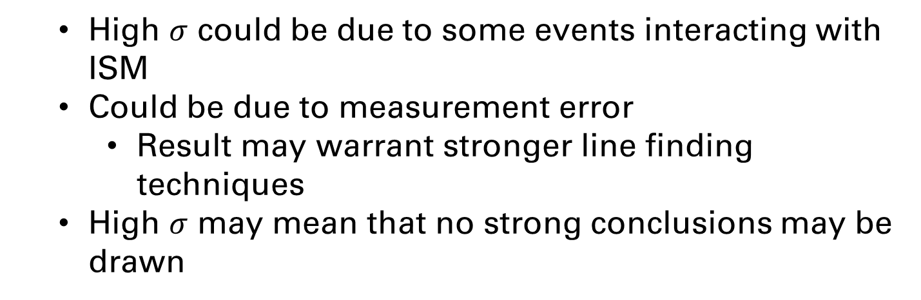
Interpretation
High $σ$ could be due to some events interacting with ISM
Could be due to measurement error
Result may warrant stronger line finding techniques
High $σ$ may mean that no strong conclusions may be drawn

Slide 14
Takeaways and Next Steps
Attempt to verify progenitor redshifts myself
Better absorption line analysis
Try to get more parameters (e.g. peak magnitude)
Would have to cross reference with other data sets
Be less strict with filtering to be able to analyze other SNIa subtypes

